Slide 1



Slide 2


Slide 3
Contents :
What is a Buffer?
What is a Buffer Overflow vulnerability?
How does a Buffer Overflow vulnerability work?
Types of Buffer Overflow in Web Applications.
Live Demo.

Slide 4
What is a Buffer?
Buffer is a temporary storage area, typically in memory, that holds data while it is being processed, transferred, or manipulated.

Slide 5
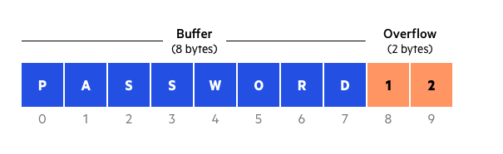
What is a Buffer Overflow Vulnerability?
A buffer overflow occurs when a program tries to write too much data in a fixed length block of memory (a buffer).

Slide 6
How Does a Buffer Overflow Vulnerability Work?
A buffer overflow vulnerability occurs when a program attempts to write more data to a buffer than it can hold.
This can happen when the program does not properly validate the size of the data being written to the buffer.
Attackers can take advantage of buffer overflow vulnerabilities by sending specially crafted input data to the program.
The extra data can overwrite adjacent memory locations, potentially leading to a crash, privilege escalation, or the execution of arbitrary code.

Slide 7
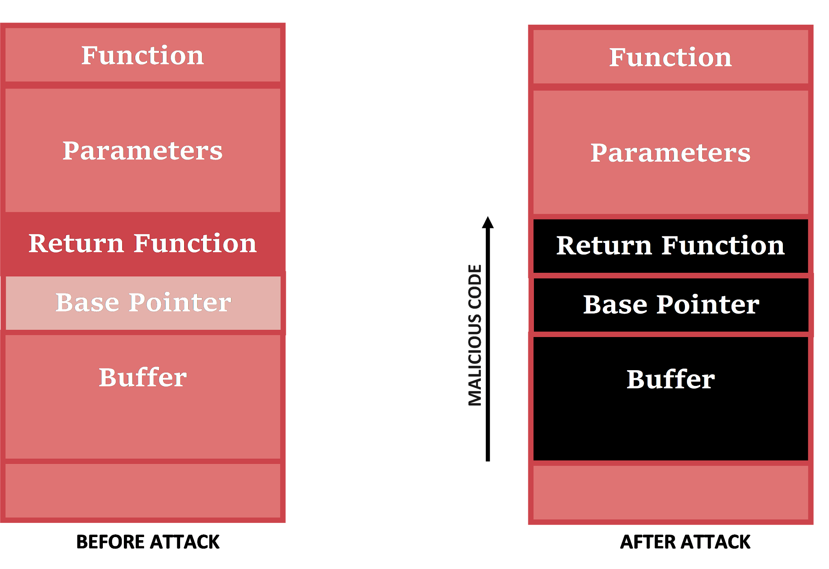

Slide 8
Types of Buffer Overflow in Web Applications

Slide 9
Stack-Based Buffer Overflow
A stack-based buffer overflow occurs when a program writes more data to a buffer on the stack than it can hold.
This can overwrite the return address of a function, potentially allowing an attacker to execute arbitrary code.

Slide 10
Heap-Based Buffer Overflow
A heap-based buffer overflow occurs when a program writes more data to a buffer on the heap than it can hold.
This can overwrite adjacent heap metadata, potentially leading to a crash or allowing an attacker to execute arbitrary code.

Slide 11
Real-World Examples of Buffer Overflow In Web-Applications
The SQL Slammer worm in 2003 exploited a buffer overflow vulnerability in Microsoft's SQL Server to spread rapidly and overwhelm internet infrastructure.
The Code Red worm in 2001 exploited a buffer overflow vulnerability in Microsoft's IIS web server to deface websites and launch distributed denial-of-service (DDoS) attacks.
The Morris worm in 1988 exploited a buffer overflow vulnerability in the Unix finger daemon to spread across the internet.

Slide 12
Mitigations
Implement Secure Coding.
Use vulnerability scanners and code analysis tools to detect for buffer overflow vulnerabilities.
Conduct regular security audits and deploy security patches as soon as they become available.

Slide 13



Slide 14
REFERENCES :-
https://owasp.org/www-community/vulnerabilities/Buffer_Overflow
https://www.hacksplaining.com/prevention/buffer-overflows

Slide 15
THANK YOU

